Slide 1

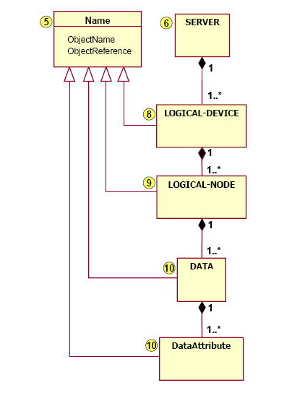
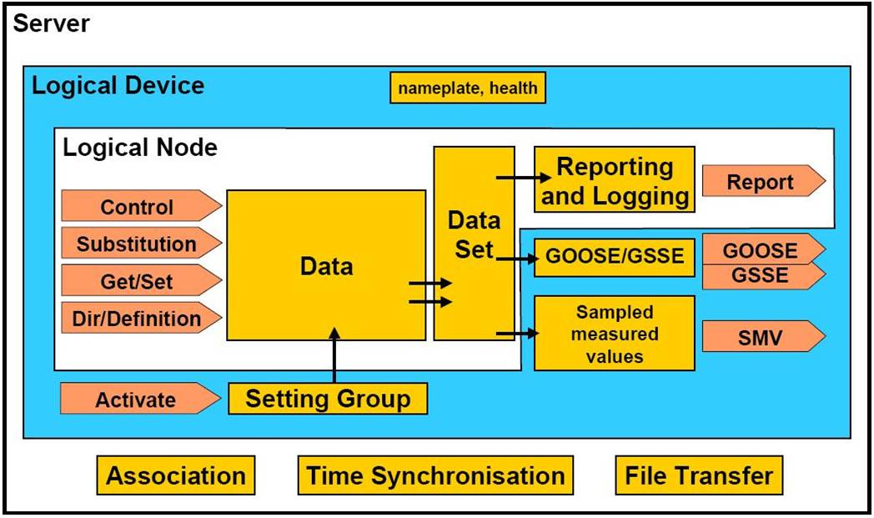
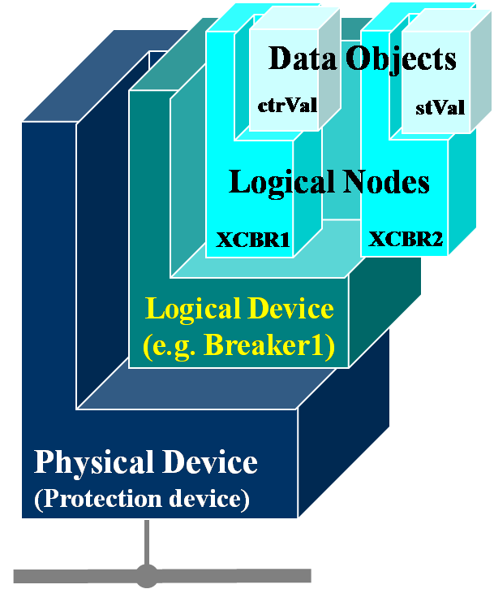
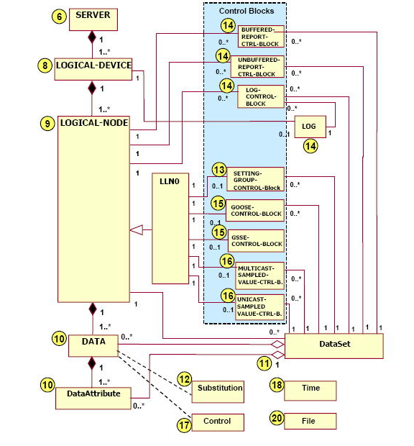
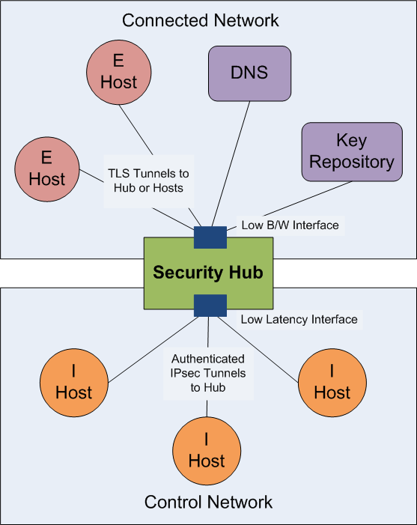
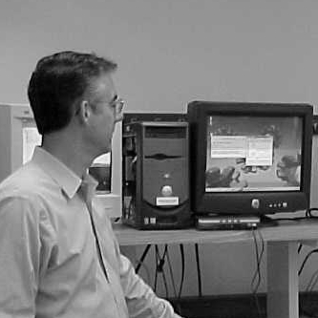

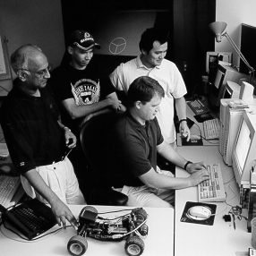
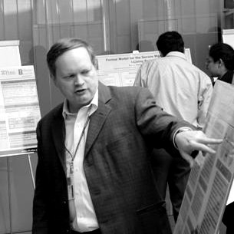

Substation Automation
Suhas Aggarwal,IIT Guwahati
Advisor-Dr. Carl Gunter
Jianqing Zhang
Background
Goals
IEC 61850- Overview
INFORMATION MODEL
HIERARCHY
  Modelling of transactions operating on the database.
CONCEPTUAL SERVICE MODEL OF THE ACSI
Research Agenda
Control network –
Implementation of Main Memory Database model compliant with IEC 61850 requirements.
Implementation of network model compliant
with IEC 61850 requirements.
Connect the two models via interface defined above.
Set up the physical architecture and measure the data transmission times between the ihosts.
External network –
Compare the performance of TLS vs XML security on the network interface between ihosts and ehosts.
Security Hub Architecture
Research Aim
To merge components of IEC 61850
with the above substation architecture and achieve a better model for substation communication
Fundamental Questions/Challenges
Related Work/Interaction with Other Projects
To study the latency challenges involved
in substation communication
Implementation of access control feature of
IEC 61850
To explore the possibilities of attacks on this
architecture
Detailed study of IEC 61850 protocol,
an international standard for substation
automation
Study and development of security hub
architecture
Information Trust Institute
University of Illinois at Urbana-Champaign
www.iti.uiuc.edu
Notes:
on

